Slide 1
Restaurant Rating Prediction

Slide 2
Cleaning data in Excel
Remove duplicate record
Handle missing value
Correct data types
Standardize case
Validate data consistency

Slide 3
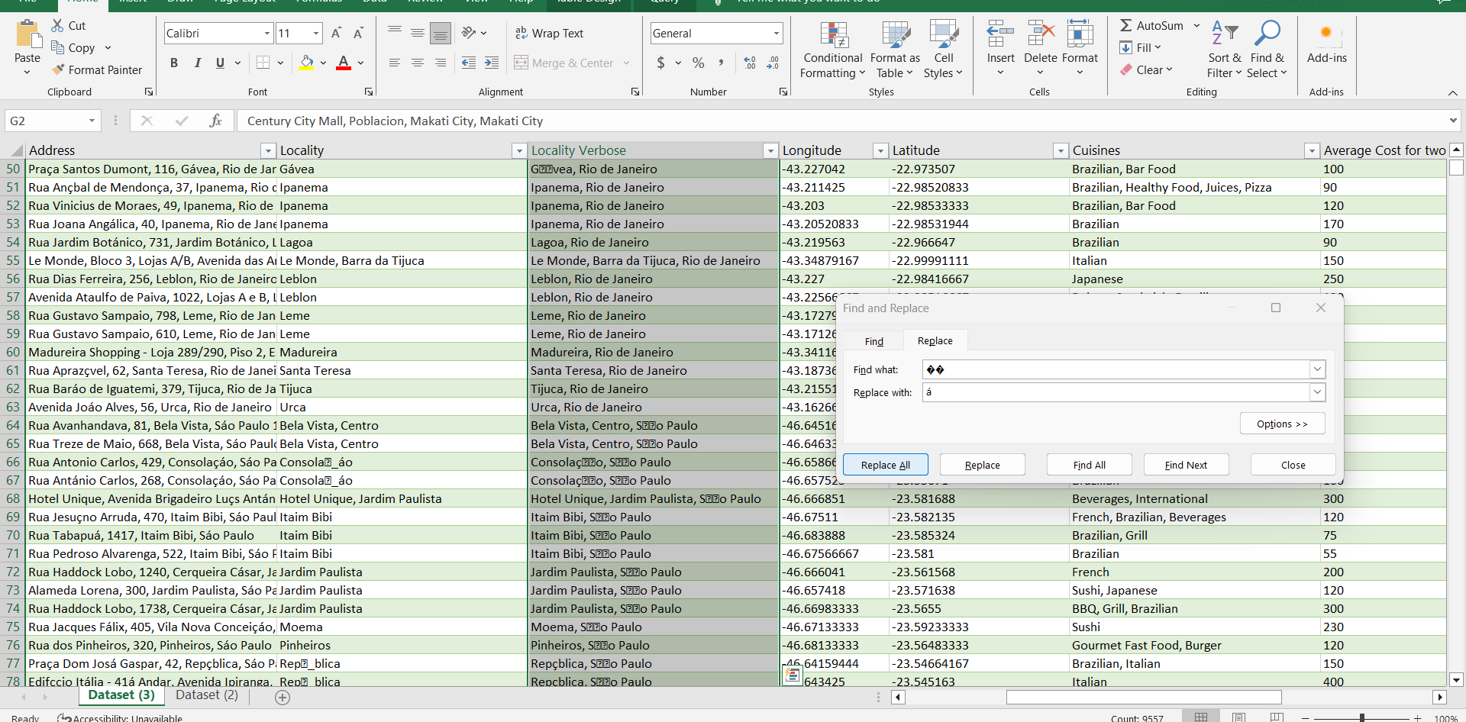
Some text appear to be corrupted or improperly encoded.

Slide 4
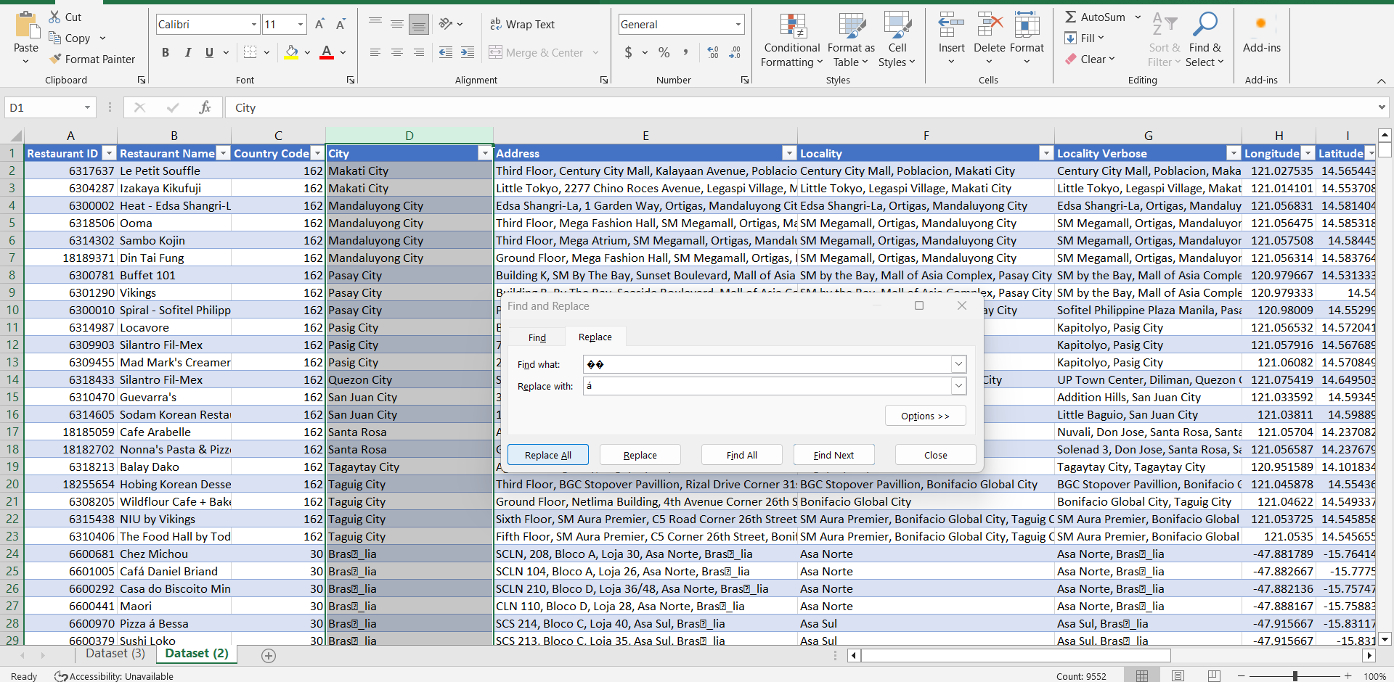

Slide 5
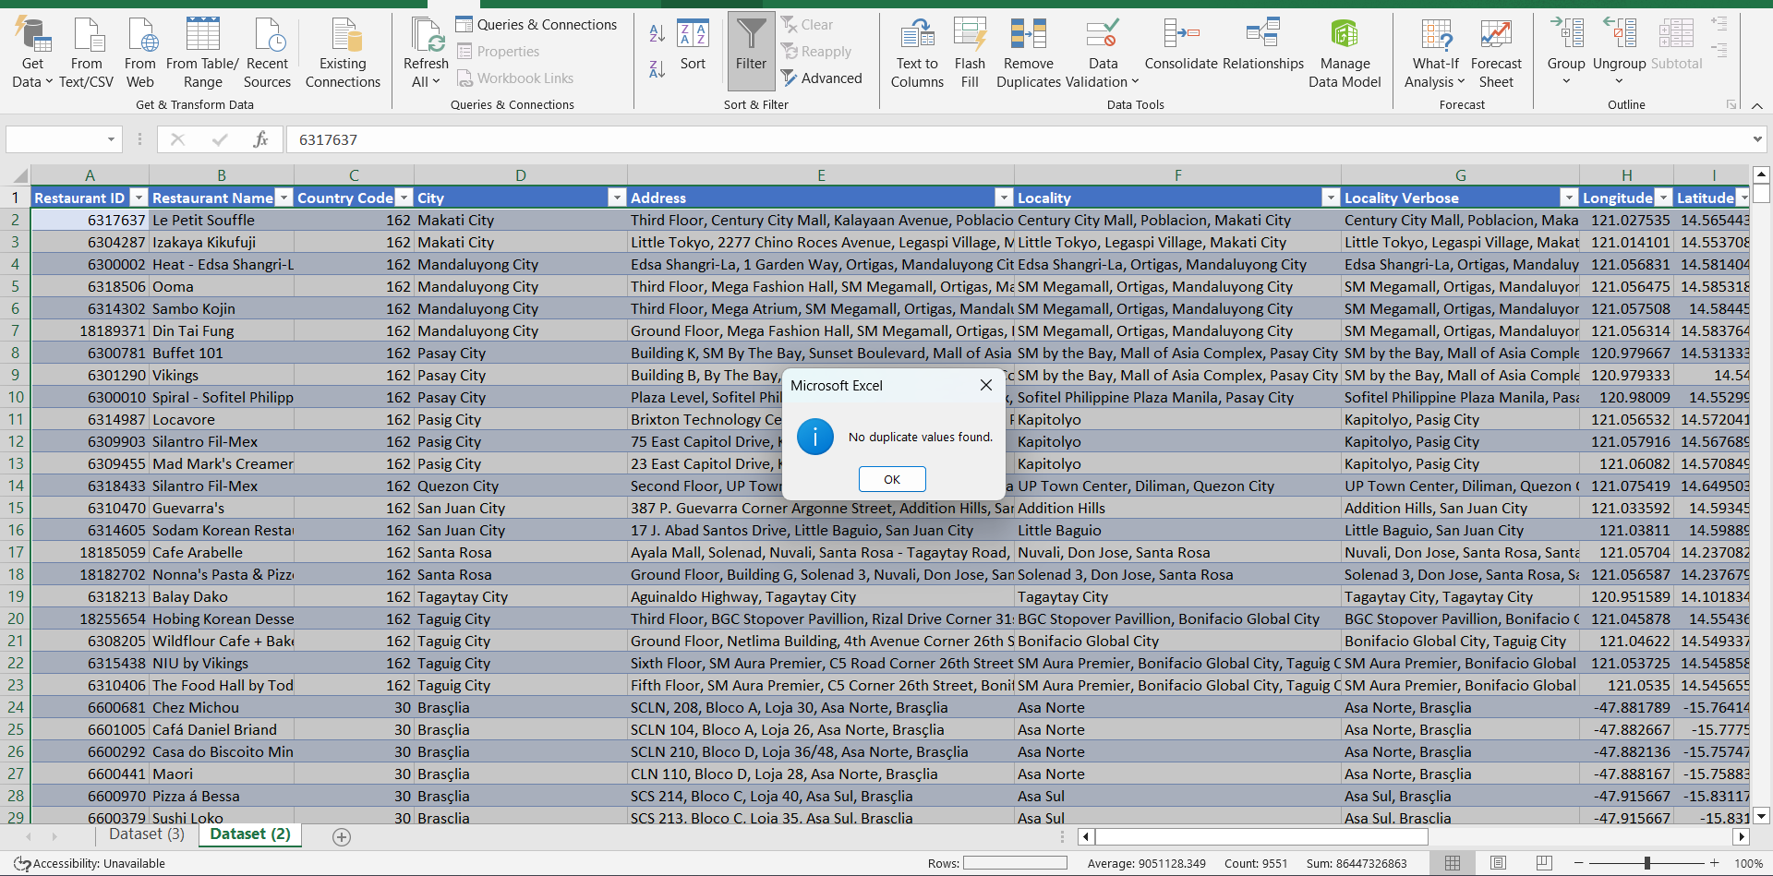
Remove duplicate record.
Go to data tab -> remove duplicate

Slide 6
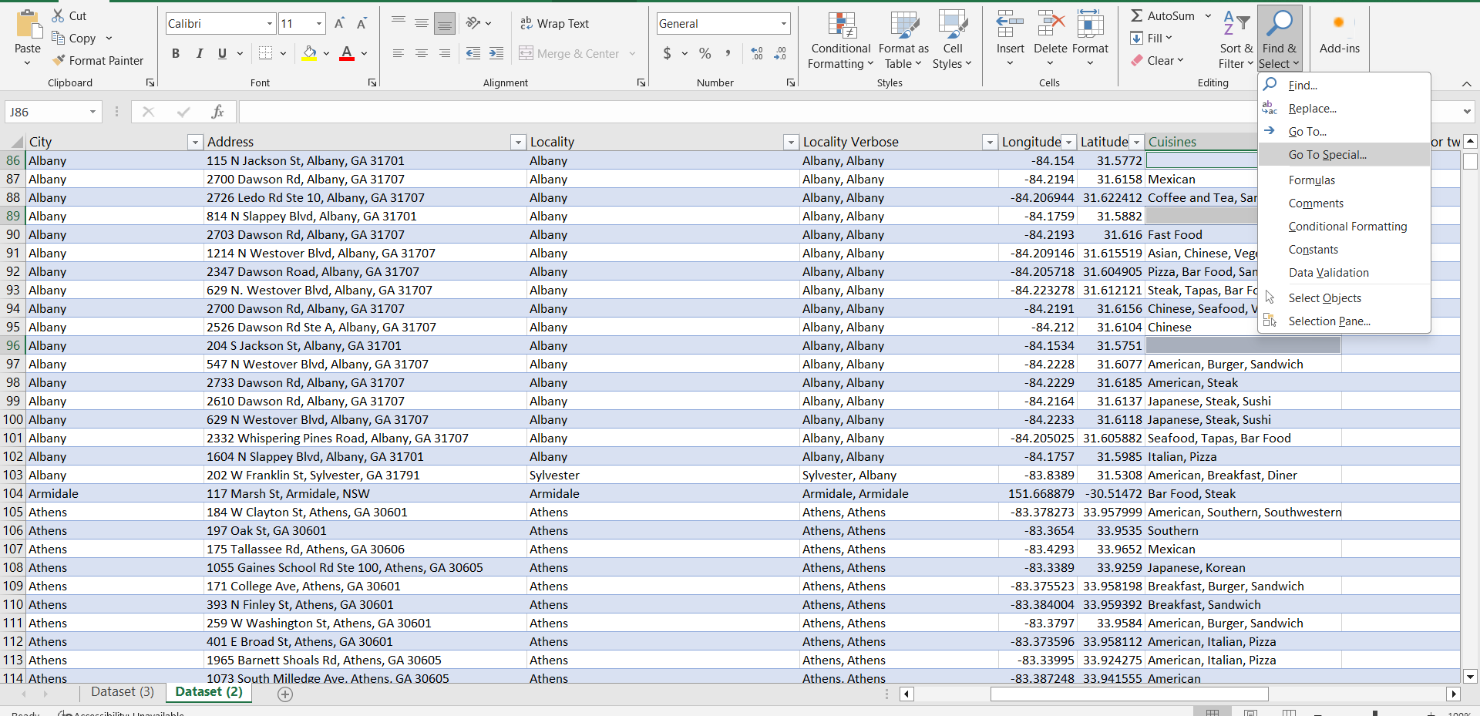
Fill or remove missing value

Slide 7
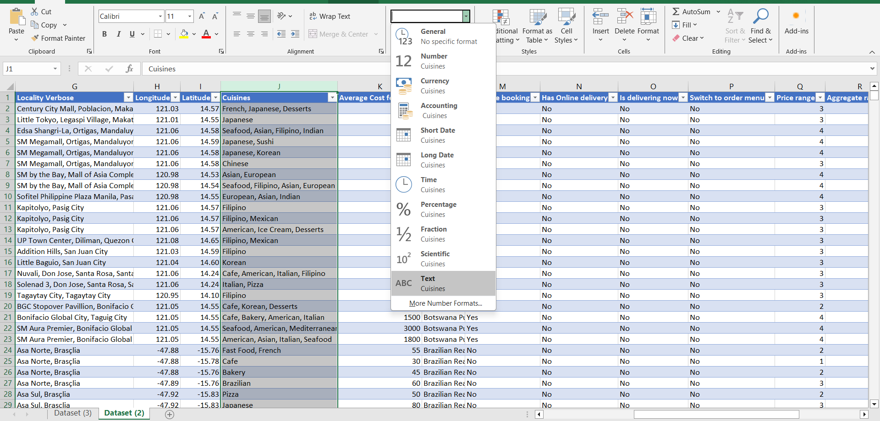
Check for correct data types

Slide 8
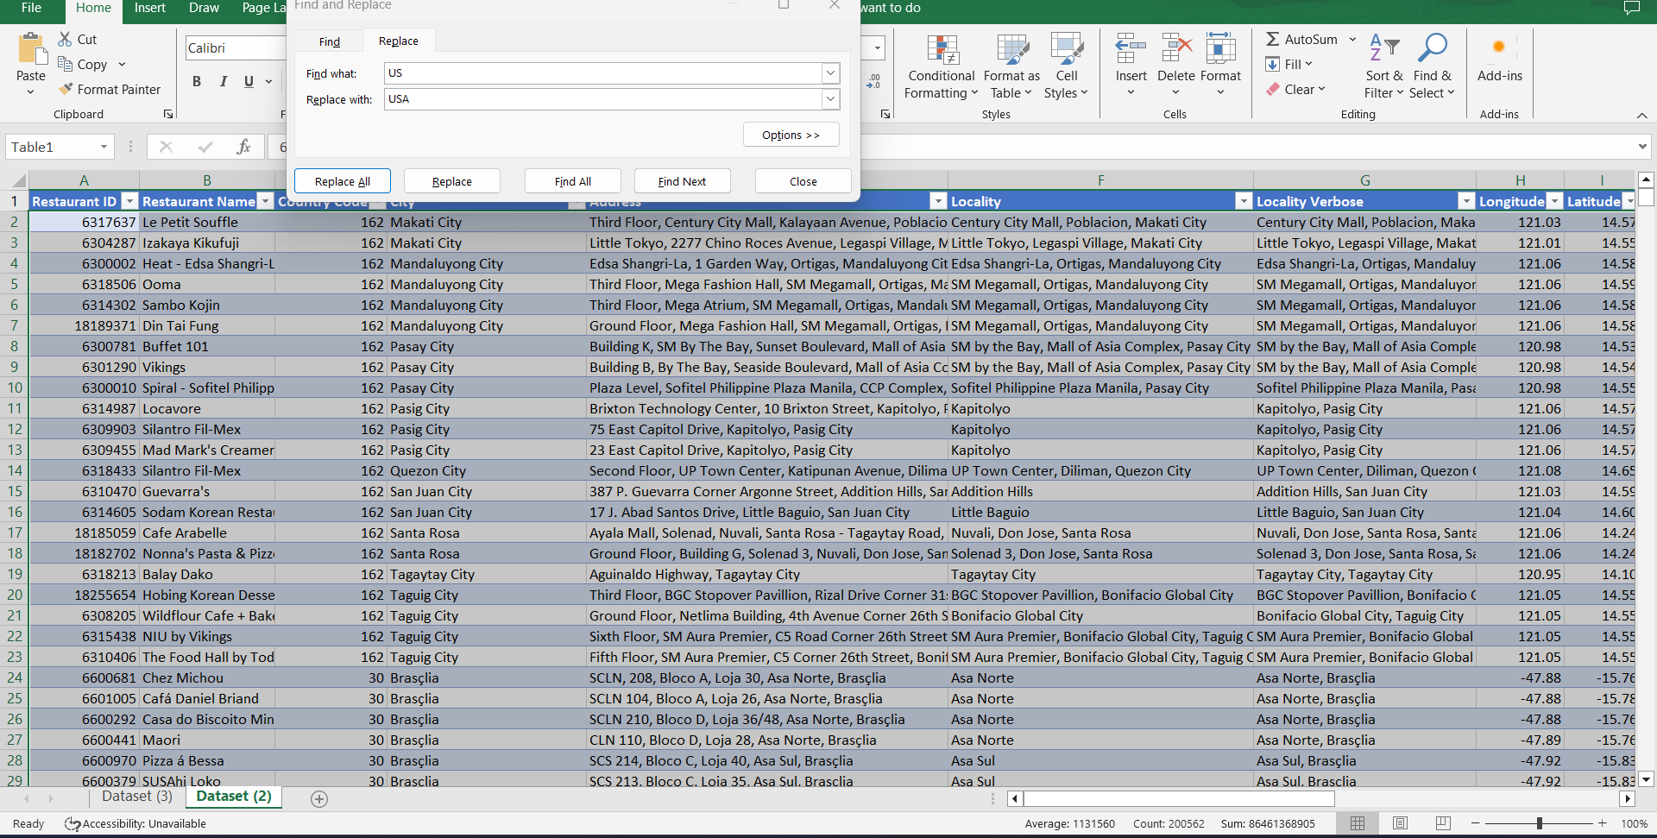

Slide 9
thank you
BRITA TAMM
502-555-0152
brita@firstupconsultants.com
www.firstupconsultants.com

